Slide 1
INFORMED (HEURISTIC) SEARCH STRATEGIES
one that uses problem-specific knowledge
beyond the definition of the problem itself, can find solutions more efficiently than can
an uninformed strategy.

Slide 2
Outline
Best-first search
Greedy best-first search
A* search
Heuristics

Slide 3
Best-first search
Best-first search is a general approach where the algorithm selects the most promising node to expand next.
The decision is based on an evaluation function f(n).
  f(n) acts as a cost estimate.
  The node with the lowest f(n) value is expanded first.

Slide 4
Best-first search
Implementation:
  It follows the same procedure as uniform-cost search, except it orders the queue using f(n) instead of g(n) (the cost so far).
Flexibility:
  By choosing different evaluation functions f, best-first search can mimic other strategies.
  For example, with the right f, even depth-first search can be seen as a special case.

Slide 5
Best-first search
Role of Heuristic Functions
Most best-first search algorithms use a heuristic function h(n) as part of f(n).
Definition:
  h(n) = the estimated cost of the cheapest path from node n to a goal state.
Key characteristics:
  Depends only on the state at node n, not the path cost so far.
  Example: In the Romania map problem, h(n) could be the straight-line distance from a city (e.g., Arad) to Bucharest (the goal).

Slide 6
Best-first search
Importance of Heuristics
Heuristic functions are the most common way to encode domain knowledge into search algorithms.
Properties:
  Nonnegative, problem-specific functions.
  Must satisfy:
    If n is a goal node, then h(n) = 0.
Their purpose is to guide the search toward the goal more directly, reducing wasted exploration.

Slide 7
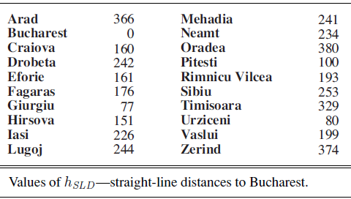
Romania with straight-line dist.

Slide 8
Greedy best-first search
Core Idea of Greedy Best-First Search
Definition:
Greedy best-first search expands the node that appears to be closest to the goal, based purely on the heuristic function.
Evaluation function:
f(n)=h(n) where h(n) is the estimated cost to reach the goal from node n.
Motivation:
The algorithm is “greedy” because it always chooses the node that seems most promising in the short term, aiming for a quick solution.

Slide 9
Greedy best-first search
Example: Romania Route-Finding
Heuristic used: Straight-Line Distance (hSLD) to the goal city Bucharest.
Example value:
h_{SLD}(Arad)=366
Characteristics of hSLD:
  Cannot be derived directly from the problem definition.
  Requires knowledge/experience that straight-line distance correlates with actual road distance.

Slide 10
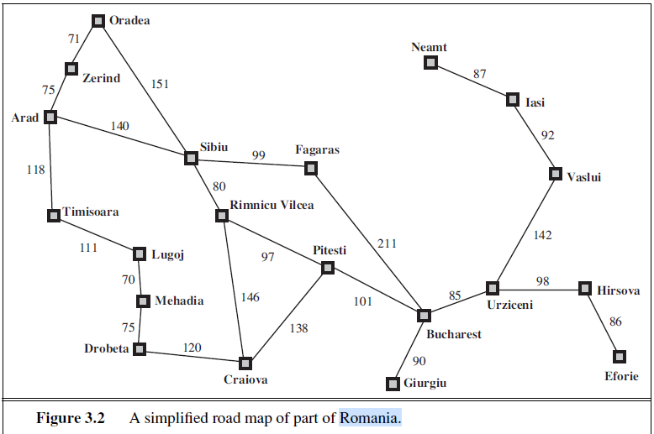

Slide 11
Greedy best-first search
Search trace:
  Start at Arad → expand Sibiu (closest to Bucharest).
  Expand Fagaras (closest next).
  Fagaras generates Bucharest, the goal.
Outcome:
  Solution found quickly with minimal search cost.
  But not optimal: path through Sibiu–Fagaras–Bucharest is 32 km longer than the optimal route via Rimnicu Vilcea–Pitesti.
Lesson: Greedy nature may sacrifice optimality for speed.

Slide 12
Greedy best-first search
Limitations of Greedy Best-First Search
Incompleteness (Tree Search):
  Example: Path from Iasi to Fagaras.
  Heuristic suggests expanding Neamt first (closest to Fagaras), but Neamt is a dead end.
  Correct path requires going away from the goal initially (via Vaslui → Urziceni → Bucharest → Fagaras).
  Algorithm fails because it cycles endlessly between Iasi and Neamt.
Graph Search version:
  Complete in finite state spaces,
  But not guaranteed in infinite state spaces.

Slide 13
Greedy best-first search
Complexity
Worst-case time and space complexity (tree version):
O(b^{m}) where:
  b = branching factor,
  m = maximum depth of the search space.
With a good heuristic, complexity is reduced significantly.
Effectiveness depends on:
  The problem structure,
  The quality of the heuristic function.

Slide 14
Greedy best-first search
. Key Takeaways
Strengths:
  Very fast when heuristics are well correlated with actual solution costs.
  Minimal search effort in some cases (e.g., Arad → Bucharest).
Weaknesses:
  Not optimal (may miss shorter paths).
  Not complete in tree-search form (may loop forever).
Name justification:
  Called “greedy” because it always chooses the locally best-looking option without considering long-term consequences.

Slide 15


Greedy best-first search example

Slide 16

Greedy best-first search example

Slide 17

Greedy best-first search example

Slide 18

Greedy best-first search example
GBFS: 140+99+211= 450
Expected : 140+80+97+101 = 418

Slide 19
Properties of greedy best-first search
Think of an example
Complete? No – can get stuck in loops.
Iasi to Fagaras
Neamt- dead end
Soln: Iasi -Vaslui-Urziceni- Bucharest-Fagaras.
Time? O(b^{m}), but a good heuristic can give dramatic improvement
Space? O(b^{m}) - keeps all nodes in memory
Optimal? No
e.g. Arad→Sibiu→Rimnicu Virea→Pitesti→Bucharest is shorter!

Slide 20
A* search: Minimizing the total estimated solution cost
Idea: avoid expanding paths that are already expensive
Evaluation function f(n) = g(n) + h(n)
g(n) = gives the path cost from the start node to node n,
h(n) = estimated cost of the cheapest path from node n to a goal node.
f(n) = estimated total cost of path through n to goal
Best First search has f(n)=h(n)
Uniform Cost search has f(n)=g(n)
if n is a goal node, then h(n) = 0.

Slide 21
Conditions for optimality: Admissibility and consistency
The first condition we require for optimality is that h(n) be an admissible heuristic.
A second, slightly stronger condition called consistency (or sometimes monotonicity) is required only for applications of A∗ to graph search

Slide 22
Admissible heuristics
A heuristic h(n) is admissible if for every node n,
h(n) ≤ h*(n), where h*(n) is the true cost to reach the goal state from n.
An admissible heuristic never overestimates the cost to reach the goal, i.e., it is optimistic
Example: h_{SLD}(n) (never overestimates the actual road distance)
Theorem: If h(n) is admissible, A* using TREE-SEARCH is optimal

Slide 23

A* search example

Slide 24

A* search example

Slide 25

A* search example

Slide 26

A* search example

Slide 27

A* search example

Slide 28

A* search example

Slide 29
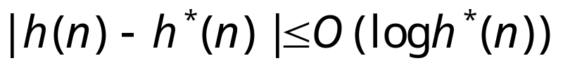
Properties of A*
Complete? A* using TREE-SEARCH is optimal if h(n) is admissible. (bucharest values>Pitesti values)
Time/Space? Exponential
except if:
Optimal? A* using TREE-SEARCH is optimal if h(n) is admissible
Optimally Efficient: Yes (no algorithm with the
same heuristic is guaranteed to expand fewer nodes)

Slide 30
Conditions for optimality: Admissibility and consistency
The first condition we require for optimality is that h(n) be an admissible heuristic.
admissible heuristic is one that never overestimates the cost to reach the goal.
Because g(n) is the actual cost to reach n along the current path, and f (n) = g(n) + h(n),
we have as an immediate consequence that f (n) never overestimates the true cost of a solution along the current path through n

Slide 31
Conditions for optimality: Admissibility and consistency
A second, condition called consistency (or sometimes monotonicity) is required only for applications of A∗ to graph search.
A heuristic h(n) is consistent if,
for every node n and every successor n′ of n generated by any action a,
the estimated cost of reaching the goal from n is no greater than the step cost of getting to n′
plus the estimated cost of reaching the goal from.
n′: h(n) ≤ c(n, a, n′) + h(n′) .

Slide 32
Conditions for optimality: Admissibility and consistency
This is a form of the general triangle inequality, which stipulates that each side of a triangle cannot be longer than the sum of the other two sides. (the sum of two sides of a triangle is always greater than the third side.)
Here, the triangle is formed by n, n′, and the goal G_{n} closest to n.
For an admissible heuristic, the inequality makes perfect sense:
if there were a route from n to G_{n} via n′ that was cheaper than h(n), that would violate the property that h(n) is a lower bound on the cost to reach Gn. triangle

Slide 33

Optimality of A* (proof)
Suppose some suboptimal goal G₂ has been generated and is in the fringe. Let n be an unexpanded node in the fringe such that n is on a shortest path to an optimal goal G.
let the cost of the optimal solution be C*.
f (G2) = g(G2) + h(G2) = g(G2) > C* .
because G2 is suboptimal and because h(G2)=0
(true for any goal node),
f (n) = g(n) + h(n) <= C* .
f(n) <=C* < f (G2) s,o G2 will not be expanded and A* must
return an optimal solution.
We want to prove:
f(n) < f(G2)
(then A* will prefer n over G2)

Slide 34
Graph Search
If we use the GRAPH-SEARCH algorithm instead of TREE-SEARCH, then this proof breaks down.
Suboptimal solutions can be returned because GRAPH-SEARCH can discard the optimal path to a repeated state if it is not the first one generated.

Slide 35
two ways to fix this problem
The first solution is to extend GRAPH-SEARCH so that it discards the more expensive of any two paths found to the same node.
The extra bookkeeping is messy, but it does guarantee optimality.

Slide 36
two ways to fix this problem
The second solution is to ensure that the optimal path to any repeated state is always the first one followed-as is the case with uniform-cost search.
This property holds if we impose an extra requirement on h(n),namely the requirement of consistency (also called monotonicity).

Slide 37

Consistent heuristics
A heuristic is consistent if for every node n, every successor n' of n generated by any action a, the estimated cost of reaching the goal from n is no greater than the step cost of getting to n
plus the estimated cost of reaching the goal from n :
h(n) ≤ c(n,a,n') + h(n')
each side of a triangle cannot be longer than the sum of the other two sides.
For an admissible heuristic, the inequality makes perfect sense: if there were a route from n to Gn via n that was cheaper than h(n), that would violate the property that h(n) is a lower bound on the cost to reach Gn.
It’s the triangle
inequality !
A* using GRAPH-SEARCH is optimal if h(n) is consistent.

Slide 38

Optimality of A*
A* expands nodes in order of increasing f value
Gradually adds "f-contours" of nodes
Contour i contains all nodes with f≤f_{i} where f_{i} < f_{i+1}

Slide 39
straight-line distances
A
6
D
1
F
3
1
h(S-G)=10
h(A-G)=7
h(D-G)=1
h(F-G)=1
h(B-G)=10
h(E-G)=8
h(C-G)=20
S
2
4
8
G
B
E
1
20
C
try yourself
The graph above shows the step-costs for different paths going from the start (S) to
the goal (G). On the right you find the straight-line distances.
Draw the search tree for this problem. Avoid repeated states.
Give the order in which the tree is searched (e.g. S-C-B...-G) for A* search.
Use the straight-line dist. as a heuristic function, i.e. h=SLD,
and indicate for each node visited what the value for the evaluation function, f, is.

Slide 40
Memory Bounded Heuristic Search: Recursive BFS
How can we solve the memory problem for A* search?
Idea: Try something like depth first search, but let’s not forget everything about the branches we have partially explored.
We remember the best f-value we have found so far in the branch we are deleting.

Slide 41
Memory Bounded Heuristic Search
The main difference between IDA* and standard iterative deepening is that the cutoff used is the f -cost (g + h) rather than the depth;
at each iteration, the cutoff value is the smallest f -cost of any node that exceeded the cutoff on the previous iteration.

Slide 42
Memory Bounded Heuristic Search
Its structure is similar to that of a recursive depth-first search, but rather than continuing indefinitely down the current path, it uses the f limit variable to keep track of the f -value of the best alternative path available from any ancestor of the current node.
If the current node exceeds this limit, the recursion unwinds back to the alternative path.

Slide 43
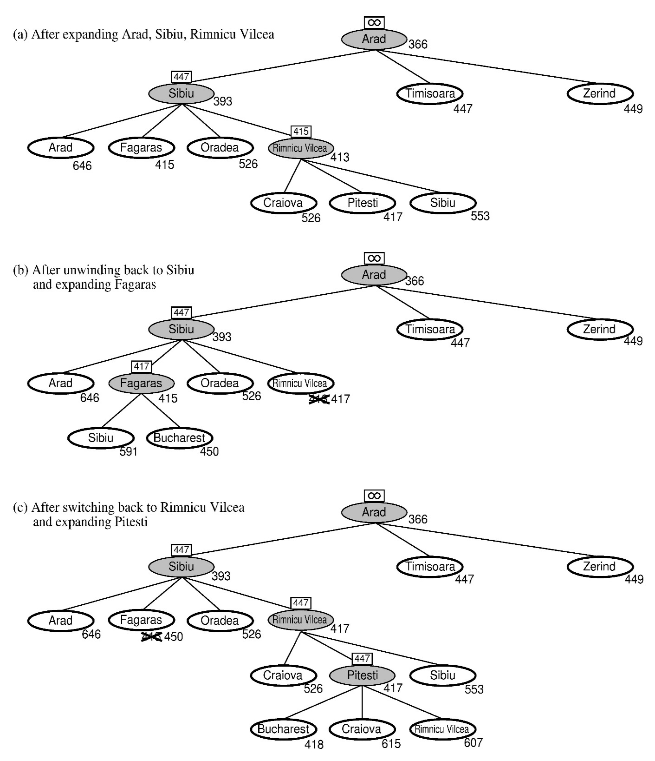
RBFS:
best alternative
over fringe nodes,
which are not children:
do I want to back up?
RBFS changes its mind
very often in practice.
This is because the
f=g+h become more
accurate (less optimistic)
as we approach the goal.
Hence, higher level nodes
have smaller f-values and
will be explored first.
Problem: We should keep
in memory whatever we can.

Slide 44
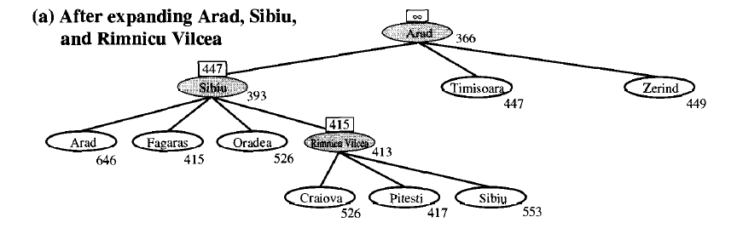
=140+253

Slide 45
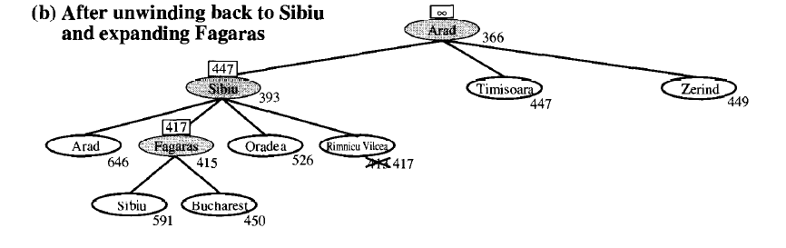

Slide 46
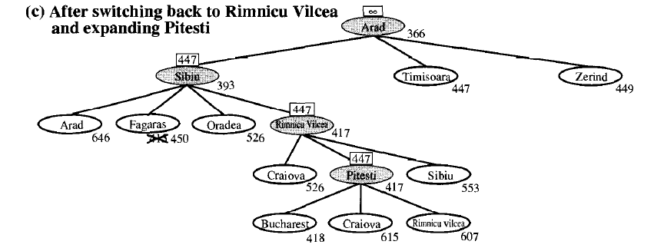

Slide 47
Simple Memory Bounded A*
This is like A*, but when memory is full we delete the worst node (largest f-value).
Like RBFS, we remember the best descendent in the branch we delete.
If there is a tie (equal f-values) we delete the oldest nodes first.
simple-MBA* finds the optimal reachable solution given the memory constraint.
Time can still be exponential.
A Solution is not reachable
if a single path from root to goal
does not fit into memory

Slide 48
Admissible heuristics
h1 = the number of misplaced tiles. start state would have h1 = 8.
h1 is an admissible heuristic because it is clear that any tile that is out of place must be moved at least once.
h2 = the sum of the distances of the tiles from their goal positions.
Because tiles cannot move along diagonals, the distance we will count is the sum of the horizontal and vertical distances.

Slide 49
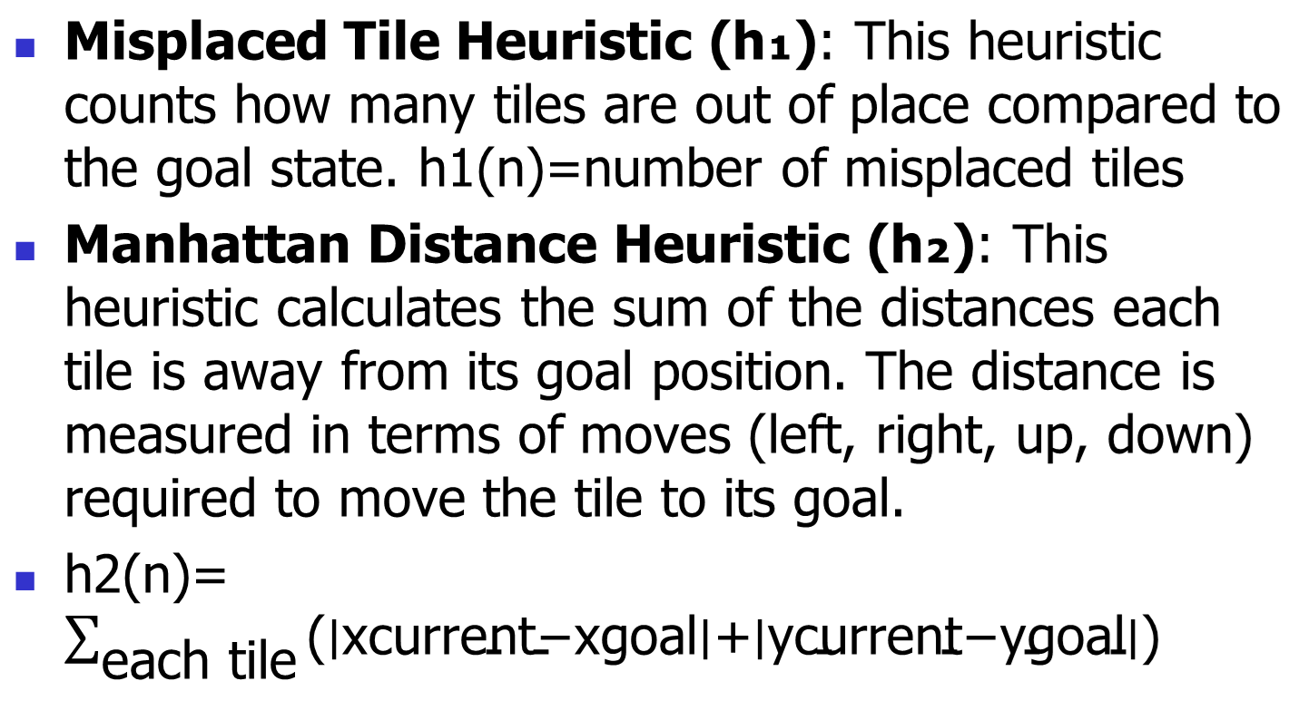
Admissible heuristics

Slide 50

Admissible heuristics
E.g., for the 8-puzzle:
h₁(n) = number of misplaced tiles
h₂(n) = total Manhattan distance
(i.e., no. of squares from desired location of each tile)
h₁(S) = ? 8
h₂(S) = ? 3+1+2+2+2+3+3+2 = 18

Slide 51
Admissible heuristics
E.g., for the 8-puzzle:
h₁(n) = number of misplaced tiles
h₂(n) = total Manhattan distance
(i.e., no. of squares from desired location of each tile)
h₁(S) = ?
h₂(S) = ?

Slide 52


Admissible heuristics
E.g., for the 8-puzzle: Use A* algorithm to solve this. ( use pathcost as 1 and h1 for heuristic search)
h₁(n) = number of misplaced tiles
h₂(n) = total Manhattan distance
(i.e., no. of squares from desired location of each tile)
Start state Start state Goal state

Slide 53
Admissible heuristics
E.g., for the 8-puzzle:
h₁(n) = number of misplaced tiles
h₂(n) = total Manhattan distance
(i.e., no. of squares from desired location of each tile)
Start state Goal state
1 2 3 1 2 3
4 8 _ 4 5 6
7 6 5 7 8 _
h₁(S) = ? 3
h₂(S) = ? 0+0+0+0+2+2+0+1 = 5

Slide 54
Limitations of DFS and BFS in the 8-Puzzle Problem
DFS: Can get stuck in deep, unproductive paths, leading to excessive memory usage and slow performance.
BFS: Explores all nodes at the current depth level, making it inefficient as it does not prioritize promising paths.
Optimizing with Branch and Bound (B&B)
Branch and Bound enhances search efficiency by using a cost function to guide exploration.
Intelligent Node Selection: Prioritizes nodes closer to the goal, unlike DFS (blind) or BFS (equal priority).
Pruning: Eliminates unpromising paths to save time and memory.

Slide 55
Limitations of DFS and BFS in the 8-Puzzle Problem
Using DFS - O(n!) Time and O(n!) Space
Using BFS - O(n!) Time and O(n!) Space
Using Branch and Bound - O(n^2 * n!) Time and O(n^2) Space

Slide 56
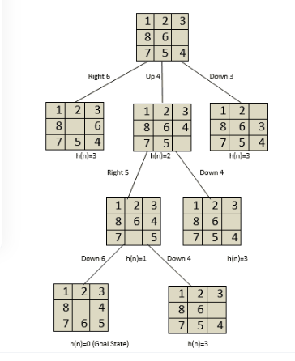

Slide 57
Consider a state space where the start state is number 1 and each state k has two
successors: numbers 2k and 2k + 1.
a. Draw the portion of the state space for states 1 to 15.
b. Suppose the goal state is 11. List the order in which nodes will be visited for breadthfirst
search, depth-limited search with limit 3, and iterative deepening search.
c. How well would bidirectional search work on this problem? What is the branching
factor in each direction of the bidirectional search?

Slide 58
